Slide 1
Convolution
Berkin Deniz Kahya
No idea what else to write here ^^

Slide 2
Contents
Convolution Operation
Probabilistic Approach
Sliding Window
Signal Processing
1D Signal Processing Examples
2D Spatial Filtering Examples
Brief mention of Importance & Neural Networks

Slide 3
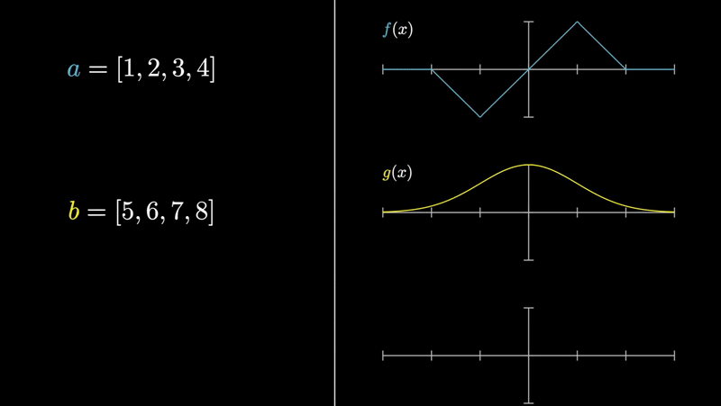
Combining two signals
*3Blue1Brown sample

Slide 4
We use them in…
Image processing
Solving differential equations
Probability theory
you can also multiply polynomials :p

Slide 5


Definition
Could be a bit overwhelming

Slide 6
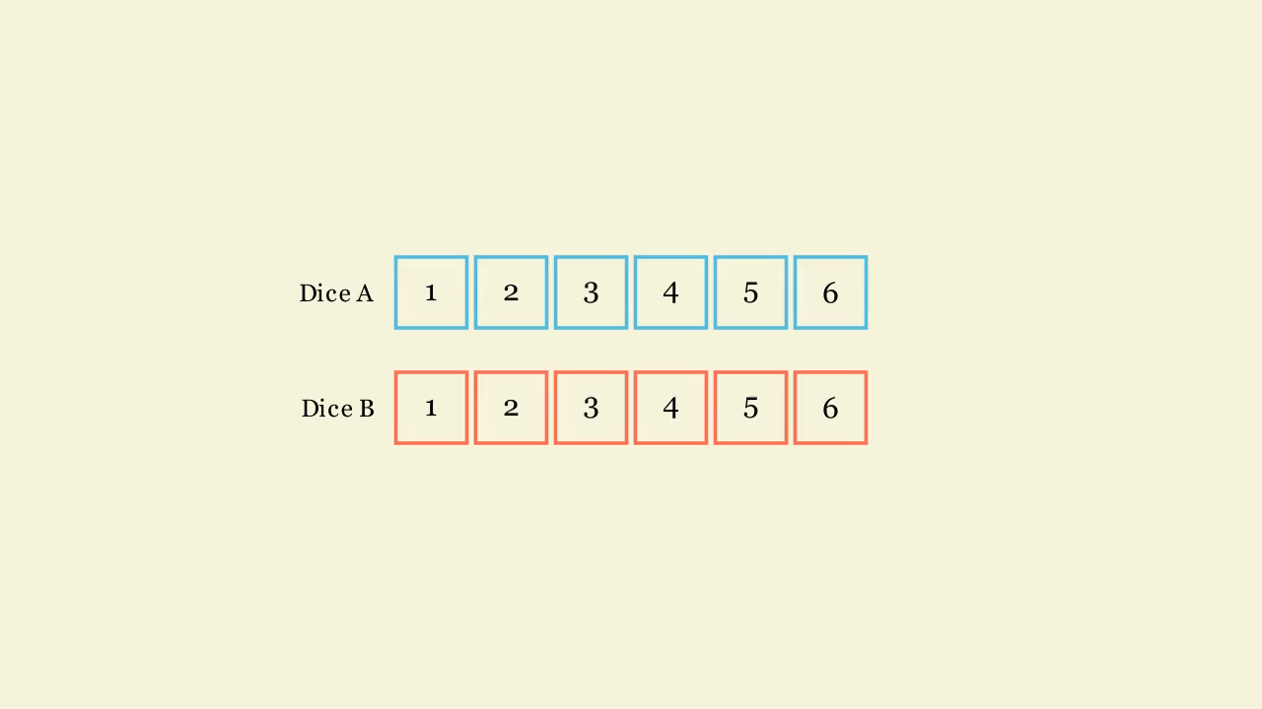

Probabilistic Approach

Slide 7
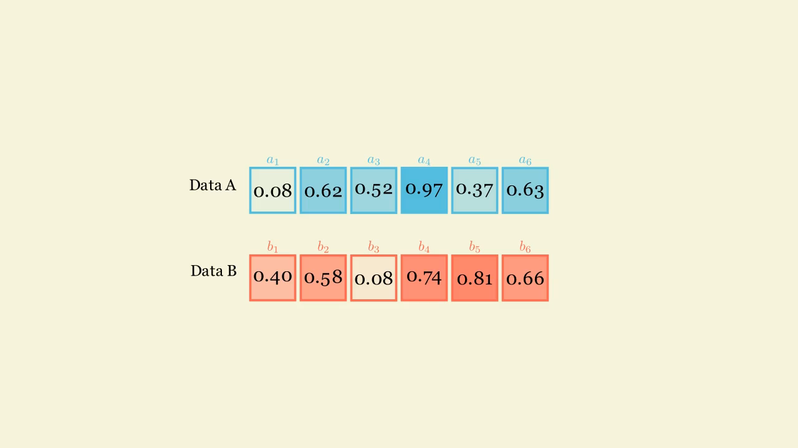
Probabilistic Approach

Slide 8
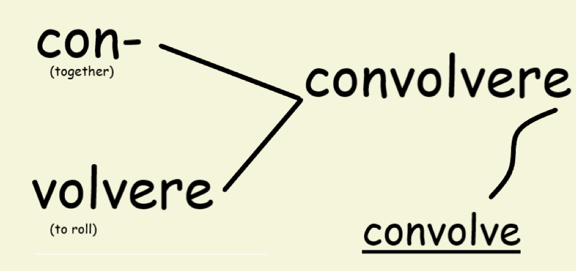
Etymology?

Slide 9
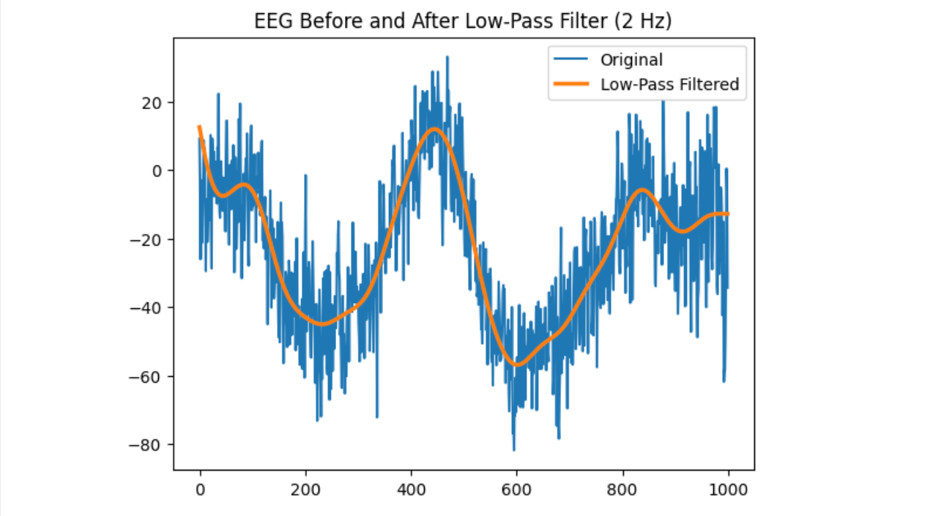
1D Signal Examples
Low pass filter [noise cancelling / reduction]
Reduce instability caused by noise in the environment [system that produces the noisy function]
*code sample

Slide 10
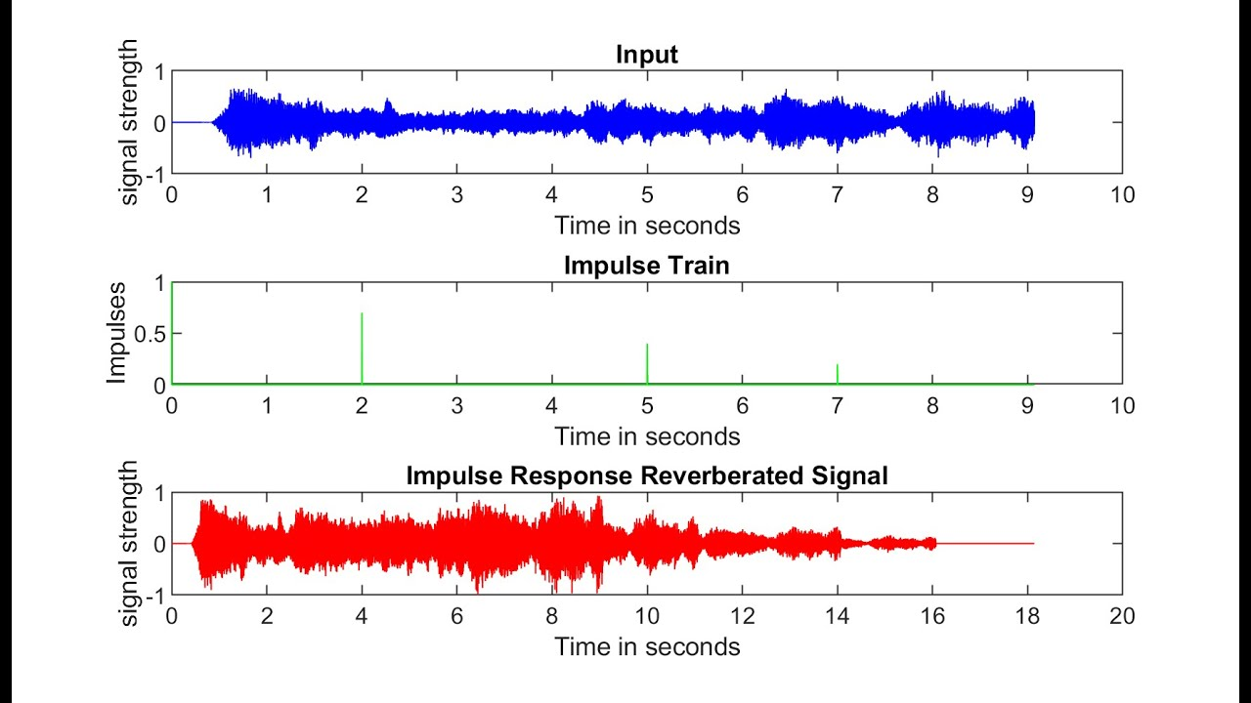
1D Signal Examples
Sound echo/reverb
Longer than original
May have overlapping issue
*code example

Slide 11
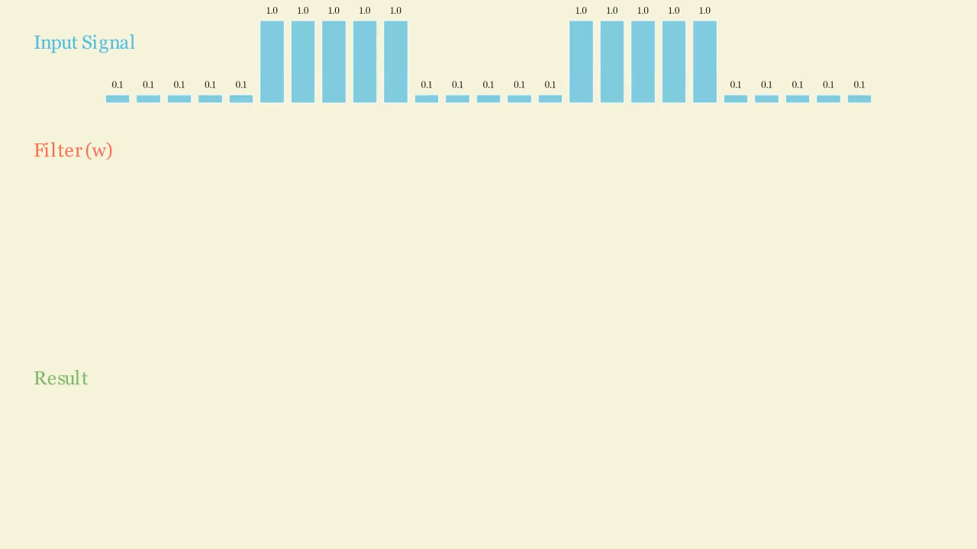
1D Signal Examples

Slide 12
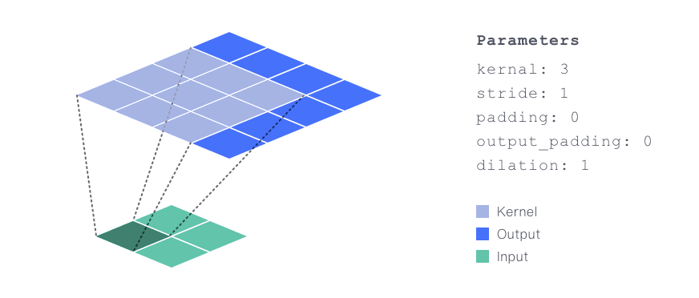
2D Convolution Operation

Slide 13
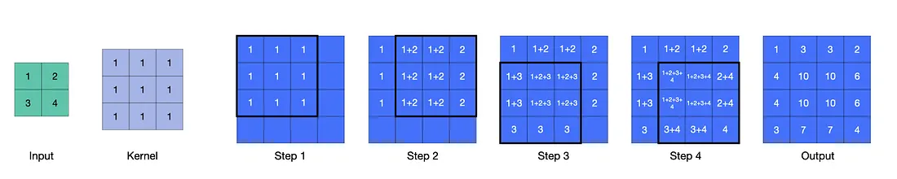
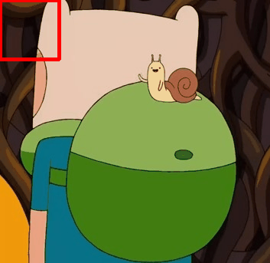
2D Convolution – Sliding window in (x, y)

Slide 14
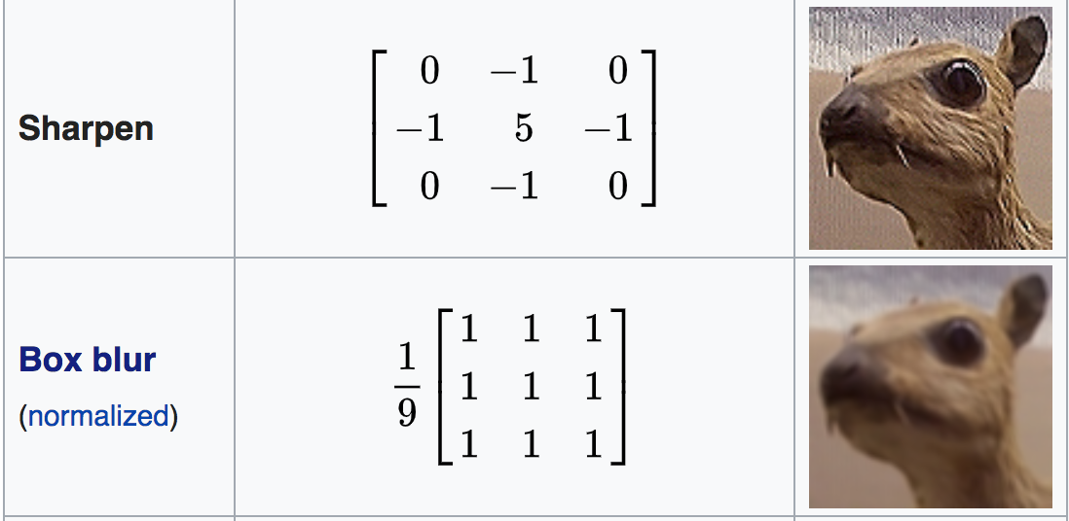
2D Convolution Example
*code example

Slide 15
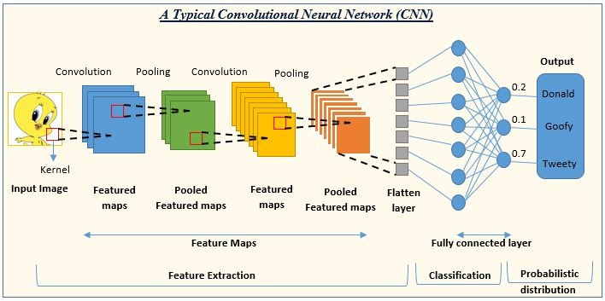
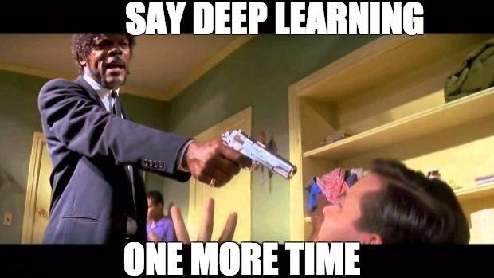
Convolutional Neural Networks
Neural networks use an arbitrary number of weights (floating point numbers) and update them to a specialized metric
They basically work as feature extractors
So why not use 2D Convolution Filters as weights to extract spatial information.

Slide 16
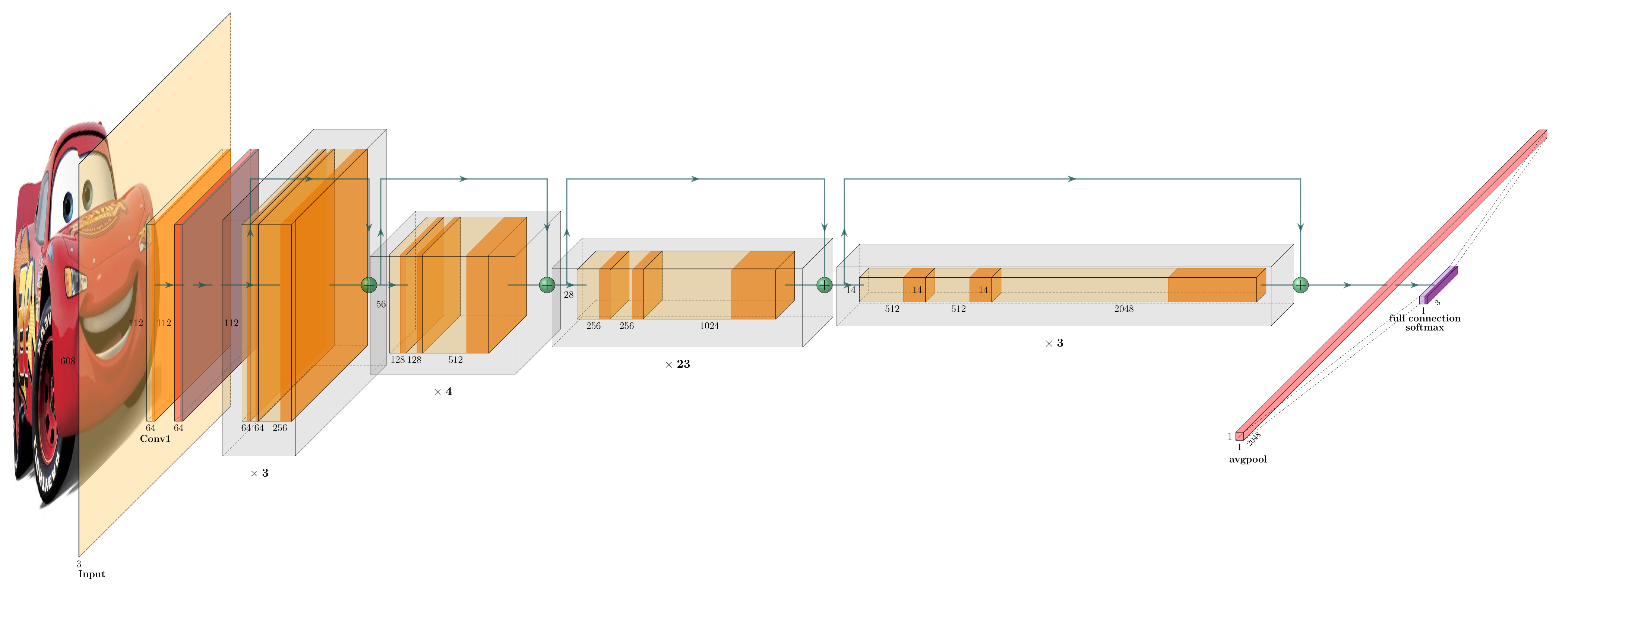
ResNet Architecture
Deeper models were achieved through residual connections in networks. Allowed huge trainings, foundation models like YOLO.

Slide 17

Various Tasks
Detection
Classification
Multi Object Classification
Tracking
Sensor Fusion
and much more

Slide 18
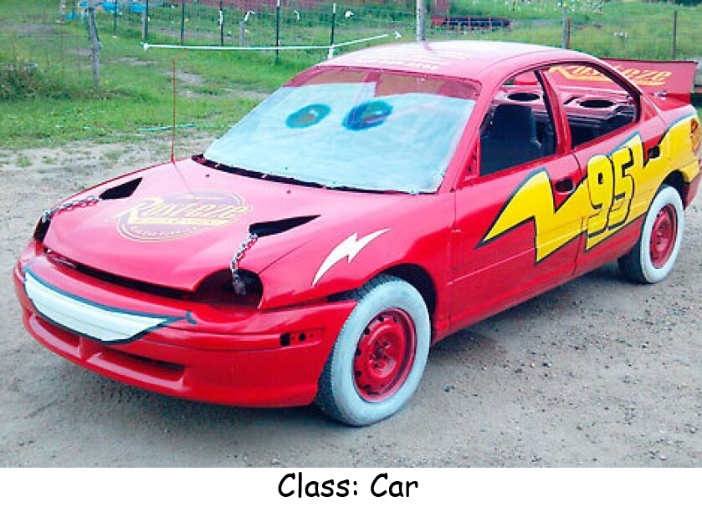
Various Tasks

Slide 19

Thanks for listening.
Any questions?

